Slide 1

Saint Paul 99 Project II
Beryl Kaczmarczik
Farshad Esnaashari
Katherine Rootes
Matt Pollari

Slide 2

Baby (Yoda) Picture
Share the obligatory cute baby photo we must. Yes, hrrmmm.
Episodic Photos, Disney

Slide 3
Data Set We Chose
Saint Paul Traffic Stop Data for 2017-2018
From Saint Paul Minnesota Public Safety
Web Site:
https://information.stpaul.gov/Public-Safety/Saint-Paul-Police-Grid-Shapefile/ykwt-ie3e¶
GEOjSON Shapes:
https://information.stpaul.gov/api/geospatial/ykwt-ie3e?method=export&format=GeoJSON
https://information.stpaul.gov/City-Administration/District-Council-Shapefile-Map/dq4n-yj8b
Traffic Stop Dataset:
https://information.stpaul.gov/api/views/kkd6-vvns/rows.csv?accessType=DOWNLOAD
We chose this data set because it has both a time and location element that was easy to work with and was relatively clean to start from.

Slide 4
Project Requirements
We are using a MongoDB database and storing the Saint Paul traffic stop data for the years 2017 and 2018. We are accessing it through a python flask powered API. We used Jupyter Notebook to clean the data and used Python scripting to then load into Mongo. In total working with 62,562 different traffic stops.
We created a dashboard that has a Leaflet map to display multiple different layers of data to show precincts, districts pins for stop locations and choropleth for displaying gradations in the data.
We are using Plotly with a selection menu to display the data and using Chartist JavaScript library to make a time series animation. We can display the data by race and gender.
We have a geojson file read in by JavaScript for the Saint Paul Police Precinct used in the choropleth and display the precinct boundaries. We used a second GeoJSON file for displaying the District Council boundaries.

Slide 5
Pain Points
Client and Server troubles with Flask.
Troubles with 3rd Party libraries starting with APEX and went to Chartist.

Slide 6
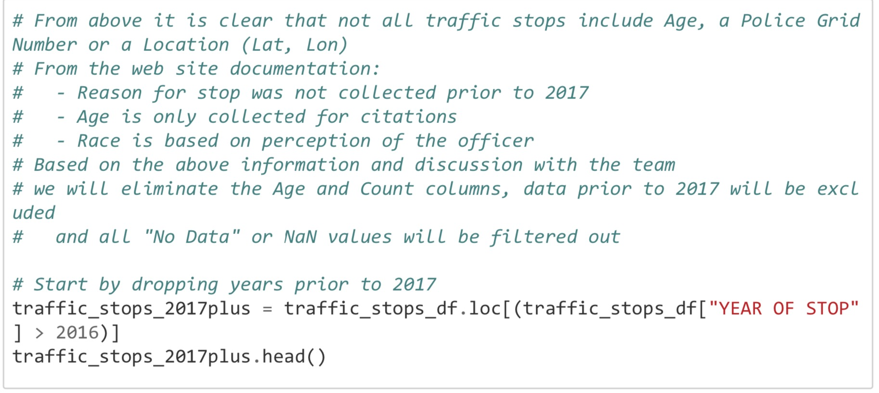
Data Clean up

Slide 7
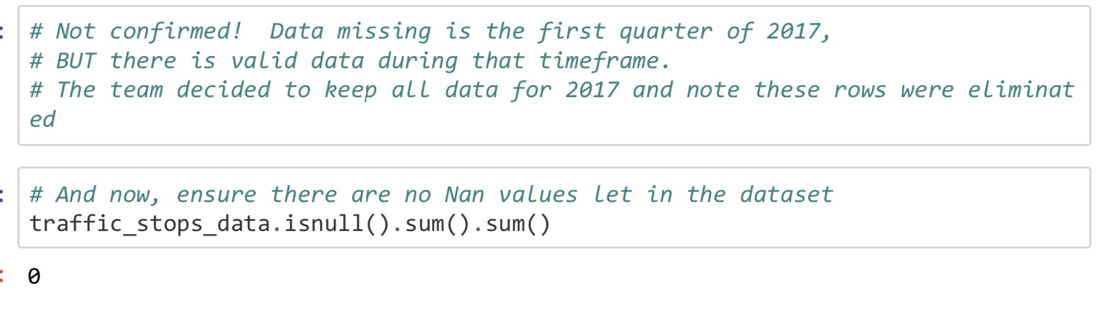
Data Clean up

Slide 8
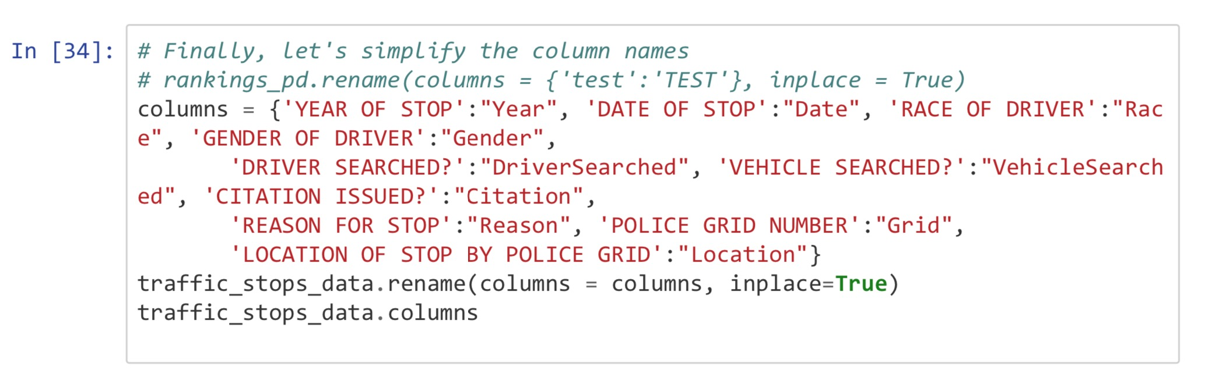
Data Clean up

Slide 9
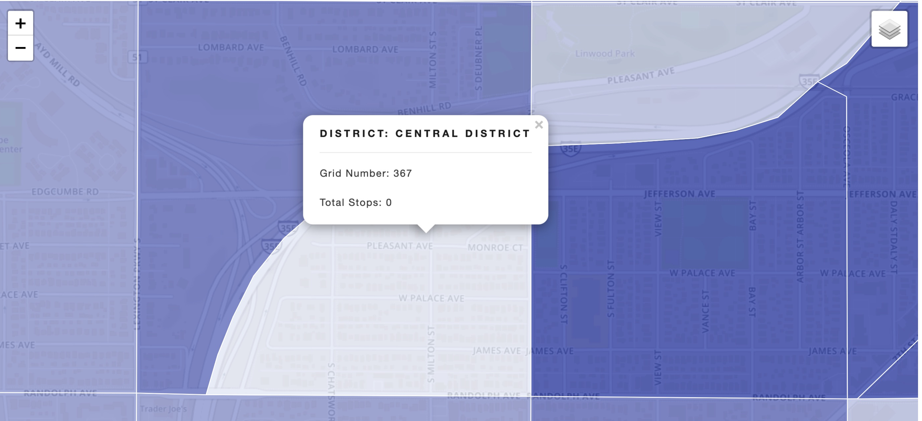
Data Clean up

Slide 10
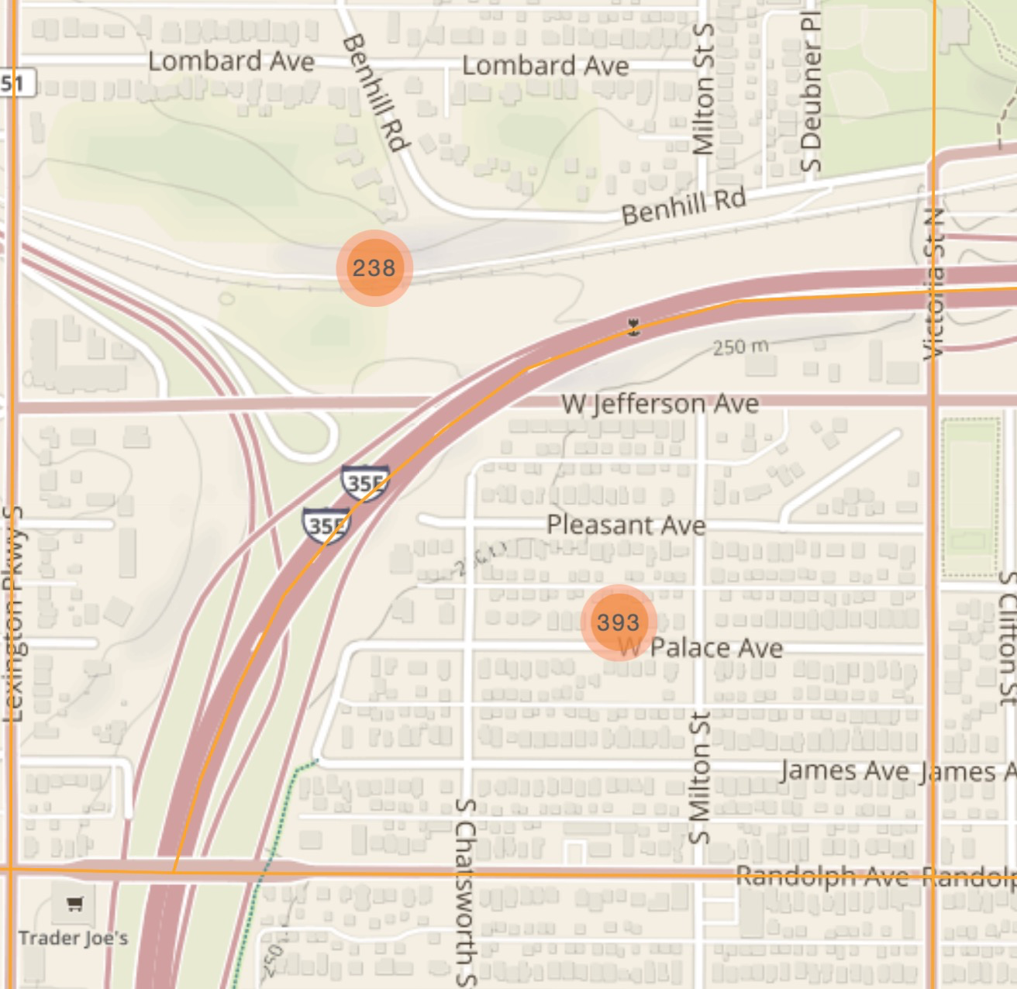
Data Clean up

Slide 11
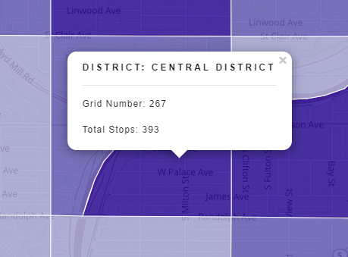
Data Clean up

Slide 12
Live Demo
Notes:
Stops by race:
Highest % of drivers/vehicles searched are black but about only X% of the stop and then 16% of the city population.
16% number comes from Census Data.

Slide 13
Observations
The police precinct with the highest number of stops was Central District #133 with 2,330 stops. That is near 94 and 52 in the Lowertown area with Union Depot.
The police precinct with the lowest number of stops was Central District #175 with one stop at the Saint Paul Downtown Airport.
Whites are the most pulled over at 25,951 with blacks coming in at 21,587, all others are under 10K. In terms of vehicle searched blacks are the most searched at 2,138 with whites at 1,108 and all others are under 1K.
Saint Paul population from 2018 ACS Census survey 57% White, 16% Black, and 18.4% Asian
Notes:
Stops by race:
Highest % of drivers/vehicles searched are black but about only X% of the stop and then 16% of the city population.
16% number comes from Census Data.

Slide 14
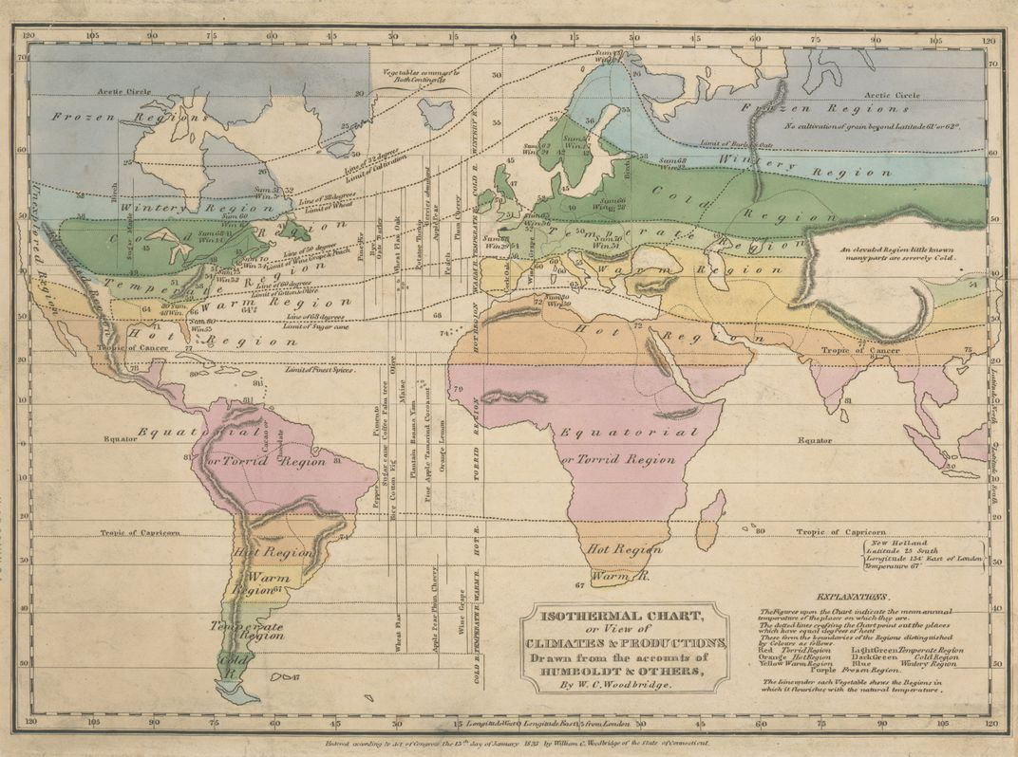
Data History
Map from 1823 from Alexander von Humboldt one of the first to use “isotherm” lines in his map to show temperature variations across the Earth.
A pioneer in using layers to show different information.
Source: https://www.smithsonianmag.com/history/pioneering-maps-alexander-von-humboldt-180973342/

